Slide 1
AI Desktop Assistant with
Face Recognition

Slide 2
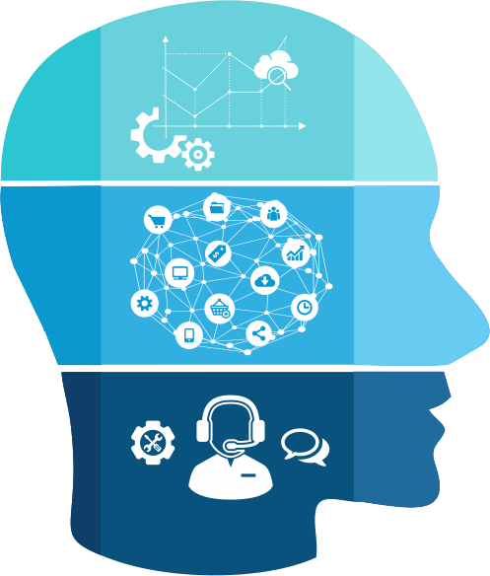

Project Guide: Vimala Mathews Scientist/Engineer ‘D’, NIELIT CALICUT
Project Members:
Rishabh Sontake
Deepam Bahre
Shubham Kishor
Suraj Kumar Sitole
Sandeep Renukuntla

Slide 3
Table of Contents
Introduction
Main Objective
Problem Definition
User Interface (GUI)
Data Flow Diagram
System Implementation
System Pre-Requisites (libraries)
Image preprocessing
Result & Analysis
Colleting Training Database
Image Capturing Face Detection
Face Recognition
Output In CSV File
Future Scope
Conclusion
References

Slide 4
Introduction
The main objective of this project is to develop face recognition based automated attendance system.
In order to achieve better performance, the test images and training images of this proposed approach are limited to frontal and upright facial images that consist of a single face only.
The test images and training images have to be captured by using the same device to ensure no quality difference.
In addition, the students have to register in the database to be recognized. The enrolment can be done on the spot through the user-friendly interface.

Slide 5
Introduction
Face detection is detecting the face location and presence of face in images. In this face detection we mostly see the nose, hair, ears, mouth, eyes and also different pose of faces in images.
It is typically used in security systems and can be compared to other biometrics such as fingerprint or eye iris recognition systems. Some facial recognition algorithms identify facial features by extracting landmarks, or features, from an image of the subject's face.

Slide 6
Main Objectives
The objective of this project is to develop face recognition based automated attendance system. Expected achievements in order to fulfil the objectives are:
• To detect the face segment from the video frame.
• To extract the useful features from the face detected.
• To classify the features in order to recognize the face detected.
• To record the attendance of the identified student.

Slide 7
Problem Definition
In this technological world humans dependency on mobiles and computers is increasing day by day. For every work one have to access the computer or any device to message, browse, learn and listen to music.
By using AI techniques this dependency can be reduced to a high extent. The person only have to instruct an assistant software to perform any task from unlocking the device to learn and sending mail.

Slide 8
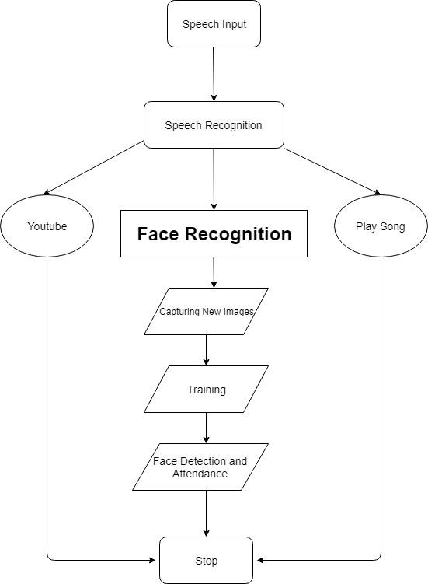
Data Flow Diagram

Slide 9
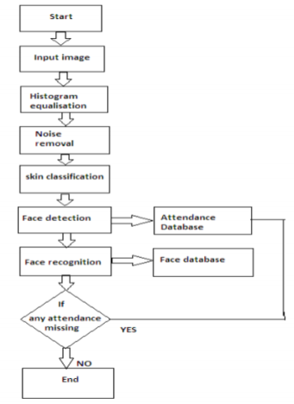

Slide 10
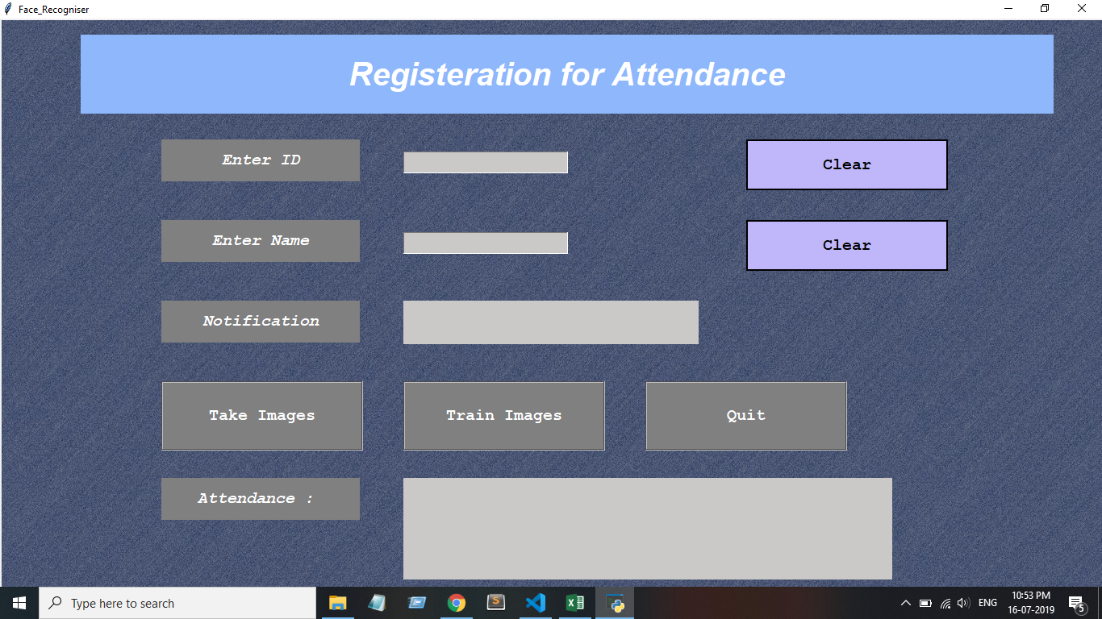
User Interface

Slide 11
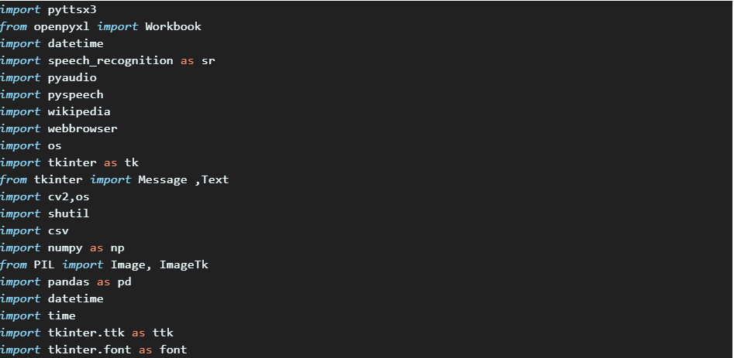
System Implementation

Slide 12
System Pre-Requisites (libraries)
Openpyxl : -Openpyxl is a Python library to read/write Excel xlsx/xlsm/xltx/xltm files. It was born from lack of existing library to read/write natively from Python the Office Open XML format. grab the active worksheet, Data can be assigned directly to cells, Python types will automatically be converted import date time
Pyttsx3: Python for text-to-speech using a cross-platform library, pyttsx3. This lets you synthesize text in to audio you can hear. This package works in Windows, Mac, and Linux.
Datetime:- Datetime is a python library to display date & time.

Slide 13
System Pre-Requisites (libraries)
Speech Recognition:- Speech Recognition is convert physical sound to an electrical signal with a microphone, and then to digital data with an analog-to-digital converter. Once digitized, several models can be used to transcribe the audio to text.
Pyaudio:- PyAudio provides Python bindings for PortAudio, the cross-platform audio I/O library. With PyAudio, you can easily use Python to play and record audio on a variety of platforms.
Wikipedia:- python provide Wikipedia library from there we can access all data of Wikipedia.
Webbrowser:- The webbrowser module provides a high-level interface to allow displaying Web-based documents to users. The webbrowser module includes functions to open URLs in interactive browser applications.

Slide 14
System Pre-Requisites (libraries)
OS:- The OS module in Python provides a way of using operating system dependent functionality.
Tkinter:- Tkinter is an inbuilt Python module used to create simple GUI apps.
You don’t need to do installation of the Tkinter module because it’s comes with Python default.
OpenCV:- OpenCV-Python is a library of Python bindings designed to solve computer vision problems. OpenCV-Python makes use of Numpy, which is a highly optimized library for numerical operations with a MATLAB-style syntax.
CSV:- The csv is a Standard Library of python whose provides Reader Objects and Writer Objects to process CSV data.

Slide 15
System Pre-Requisites (libraries)
NumPy:- NumPy is a Python package. It stands for 'Numerical Python'. It is a library consisting of multidimensional array objects and a collection of routines for processing of array.
Pandas:- Pandas is an open-source Python Library providing high-performance data manipulation and analysis tool using its powerful data structures.
PIL:- Python imaging library is a free library for the python programming language that adds support for opening, manipulating and saving many different image file formats.

Slide 16
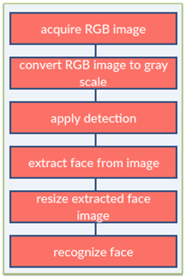
Image Preprocessing

Slide 17
Image Preprocessing code
#OpenCV2 for image processing
#OS for file path
import cv2, os
#Import numpy for matrix calculation
import numpy as np
#Import Python Image Library (PIL)
from PIL import Image
#Create Local Binary Patterns Histograms for face recognization
recognizer = cv2.face.createLBPHFaceRecognizer()
#Using prebuilt frontal face training model, for face detection
detector = cv2.CascadeClassifier("haarcascade_frontalface_default.xml");

Slide 18
#Create method to get the images and label data
def getImagesAndLabels(path):
# Get all file path
imagePaths = [os.path.join(path,f) for f in os.listdir(path)]
# Initialize empty face sample
faceSamples=[]
# Initialize empty id
ids = []
# Loop all the file path
for imagePath in imagePaths:
# Get the image and convert it to grayscale
PIL_img = Image.open(imagePath).convert('L')
# PIL image to numpy array
img_numpy = np.array(PIL_img,'uint8')
# Get the image id
id = int(os.path.split(imagePath)[-1].split(".")[1])
print(id)

Slide 19
# Get the face from the training images
faces = detector.detectMultiScale(img_numpy)
# Loop for each face, append to their respective ID
for (x,y,w,h) in faces:
# Add the image to face samples
faceSamples.append(img_numpy[y:y+h,x:x+w])
# Add the ID to IDs
ids.append(id)
# Pass the face array and IDs array
return faceSamples,ids
Get the faces and IDs
faces,ids = getImagesAndLabels('dataset')
#Train the model using the faces and IDs
recognizer.train(faces, np.array(ids))
#Save the model into trainer.yml
recognizer.save('trainer/trainer.yml')

Slide 20
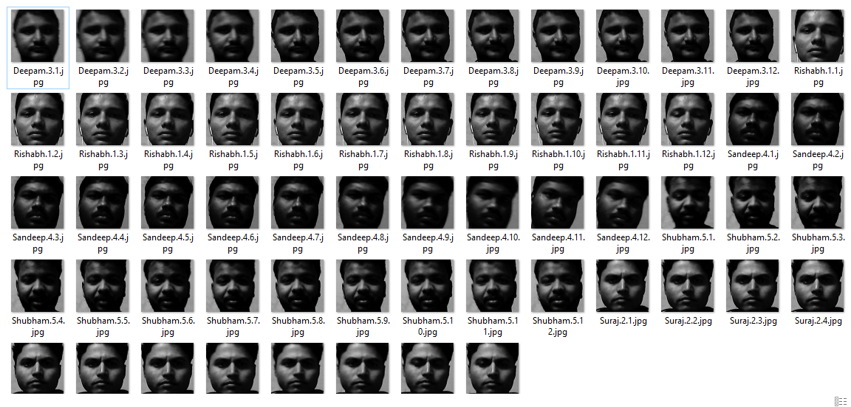
Result & Analysis
Collecting training dataset

Slide 21
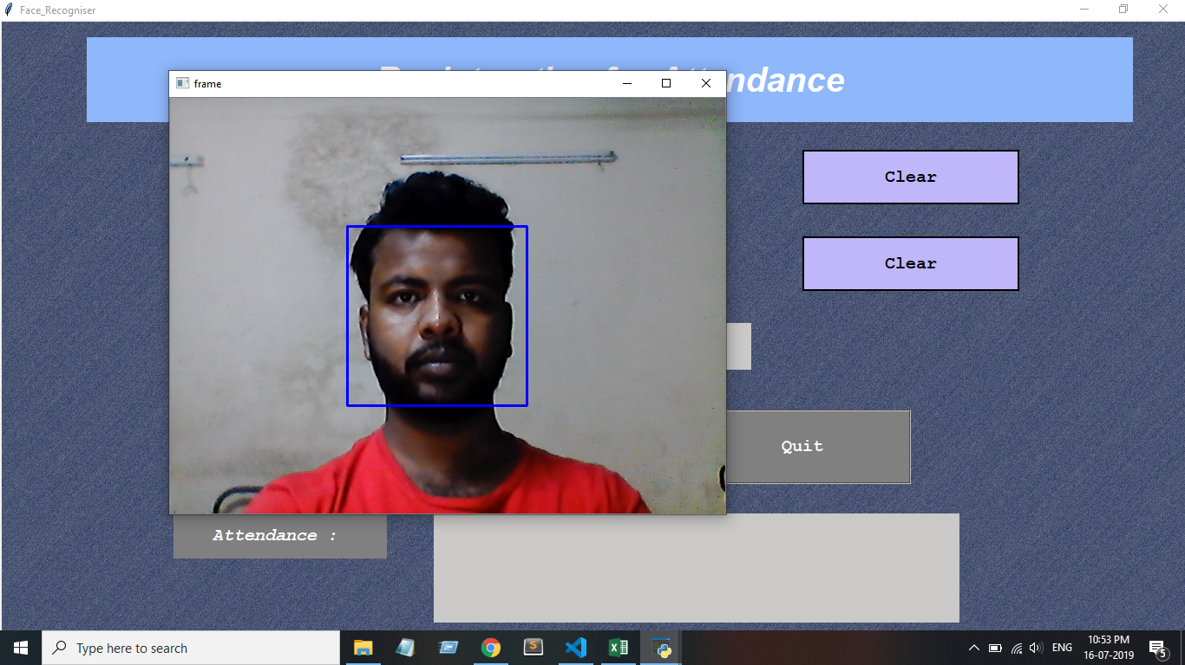
Image Capturing Face Detection

Slide 22
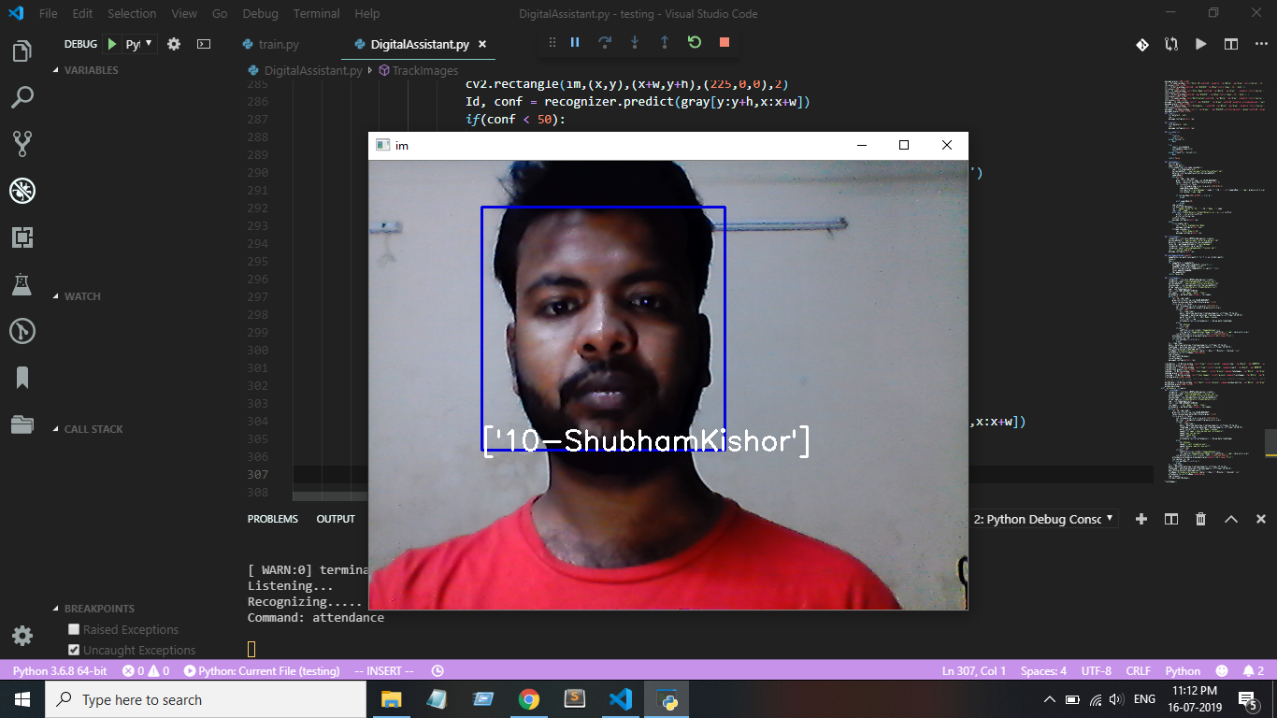
Image Capturing Face Recognition

Slide 23
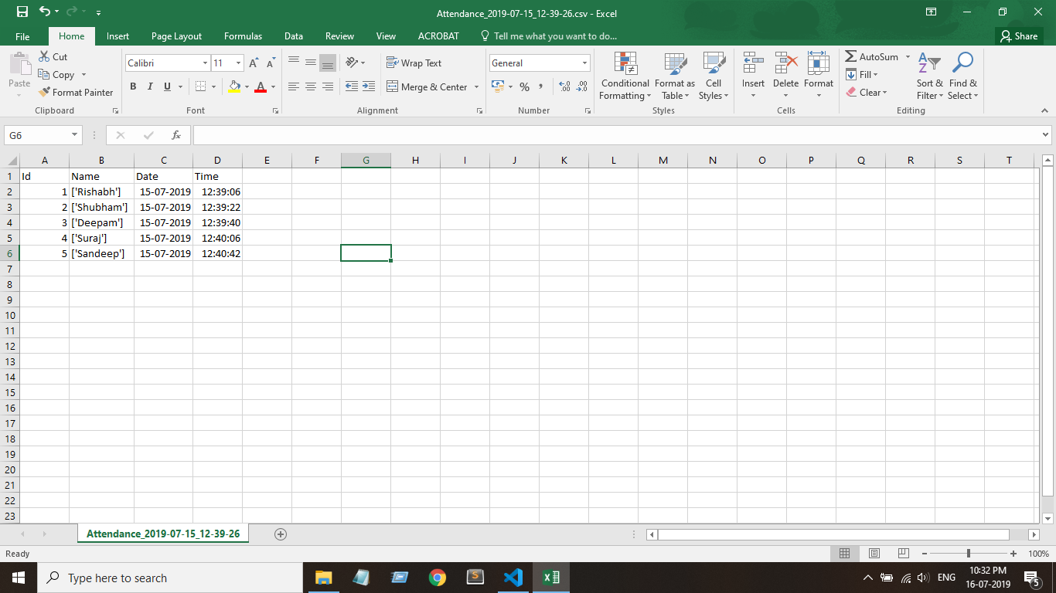
Output in CSV File

Slide 24
Future Scope
In the home, the Internet of Things, or the connectivity and integration of all the physical devices you own and their ability to exchange data, is where voice recognition will truly thrive.
Imagine for a minute your fridge advising you of the foods and beverages you are low on, crafting that grocery list without writing anything down, and having your digital assistant place the delivery order for those groceries.
Natural Language Programming (NLP) helps in giving an enhanced human experience, thereby making the chatbots more interactive. No doubts, chatbots are a great help for e-commerce stores where most of the customer issues can be filtered and move them to various consumers for clarifying their doubts.

Slide 25
Future Scope
This technology can be further developed to be used in other avenues such as ATMs, accessing confidential files, or other sensitive materials. This can make other security measures such as passwords and keys obsolete.
Another way that innovators are looking to implement facial recognition is within subways and other transportation outlets. They are looking to leverage this technology to use faces as credit cards to pay for your transportation fee. Instead of having to go to a booth to buy a ticket for a fare, the face recognition would take your face, run it through a system, and charge the account that you’ve previously created.

Slide 26
Conclusion
Capturing the images from camera or cctv camera and applying techniques face detection and recognition can decrease the manual work from human and increase the security safety, taking the decision from this recognition result.
Based on this face detection and recognition can used in implement so many application like automatic attendances system based on face recognition, worker attendances, security, safety, police application like finding thief in image that help to catching thief.
In this system we have implemented an attendance system for a lecture, section or laboratory by which lecturer or teaching assistant an record student’s attendance.

Slide 27
“Thank You”

